Slide 1
Decision Tree
by
Raghavendra N

Slide 2

WEBINAR ROUTE MAP
Recap
Classification Algorithms
Decision Tree
Naive Bayes
KNN
SVM

Slide 3

RECAP
What is Machine Learning
Types of machine learning
Supervised
Regression
Classification
Unsupervised
Clustering

Slide 4
Decision Tree
Decision trees are used for solving classification and regression problems.
Decision trees help in visualize the logic for the data we interpret
A decision tree creates a type of a flow chart which consists of nodes (referred to as leaves) and a set of decisions to be made based on these nodes (also known as branches)
They are very simple to understand and explain
Notes:
They work with small amount of data as well
This is used in business for credit risk modelling etc.
There are other business applications like in pharmacy , manufacturing etc.

Slide 5
DECISION TREE
Simple Example
Email id - internal
Yes
No
Read it
Training enquiry
Yes
No
Read it
Words like
lottery
No
Yes
Read it
spam
Notes:
https://www.dataschool.io/guide-to-logistic-regression/

Slide 6
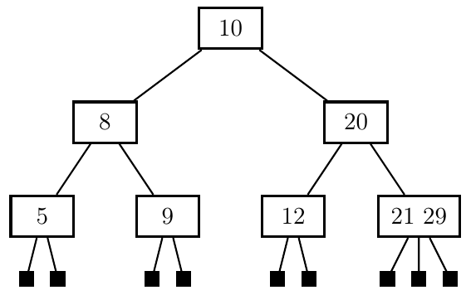
Tree Terminologies
Graph – is a set of vertices(links) and Edges(nodes) which connects a node to another through an edge
Tree – is a un-directed acyclic graph depicting a navigation or decision made
Root Node – A node with indegree of 0
Children – A node which has an indegree > 0 which is connected by a vertex to an another node
Leaf node – A node which has out degree of 0
Root
Child Nodes
Leaf Nodes

Slide 7
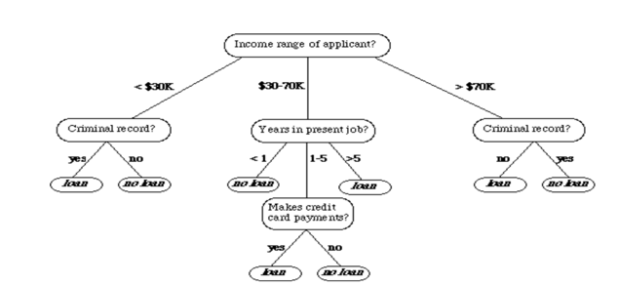
Decision Tree
Suppose we want to classify a bank loan application for a customer the decision tree may look like as depicted below for the data set shown
Decision tree is a tree where each node represents an attribute(feature) where each branch or a link represents a decision(role) and each leaf represents an outcome
Income | Criminal Record | Years of Experience | Defaults loan | Grant Loan
25000 | Y | 0.5 | Y | Y
30000 | N | 1 | Y | Y
25000 | N | 2 | N | Y
20000 | Y | 3 | N | Y
15000 | N | 2 | N | Y
30000 | N | 3 | N | N
70000 | N | 4 | N | N
45000 | N | 8 | Y | N
90000 | N | 10 | Y | Y

Slide 8
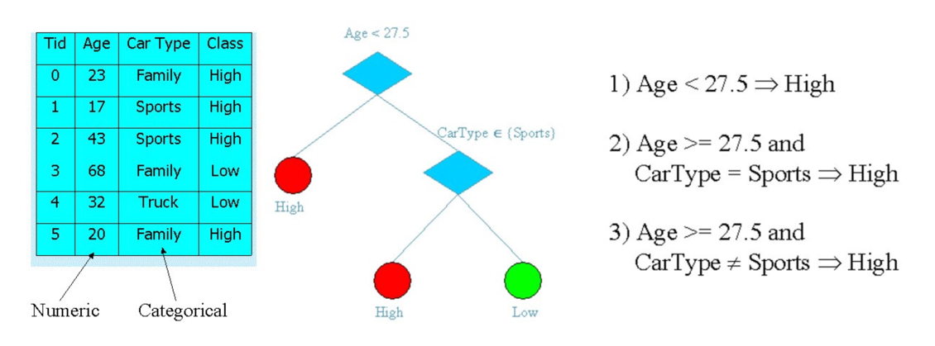
Building a decision tree

Slide 9
PRINCIPLED CRITERION
Choosing the most useful attribute for classifying examples.
Entropy
A measure of homogeneity of the set of examples
If the sample is completely homogeneous the entropy is zero and if the sample is an equally divided it has entropy of one
Information Gain
Measures how well a given attribute separates the training examples according to their target. This measure is used to select among the candidate attributes at each step while growing the tree classification

Slide 10
What is entropy?
Entropy is defined as the measure of randomness or unpredictability of the dataset
Decision tree is built from root node and involves partitioning the data into subsets that contain instances with similar values
After every split the entropy decreases.
If the sample is completely homogenous then entropy is zero and if the sample is equally divided then entropy is one

Slide 11
Understanding Entropy
6 Apples and 6 Oranges → Entropy = 1
6 Apples → Entropy = 0
6 Oranges → Entropy = 0

Slide 12
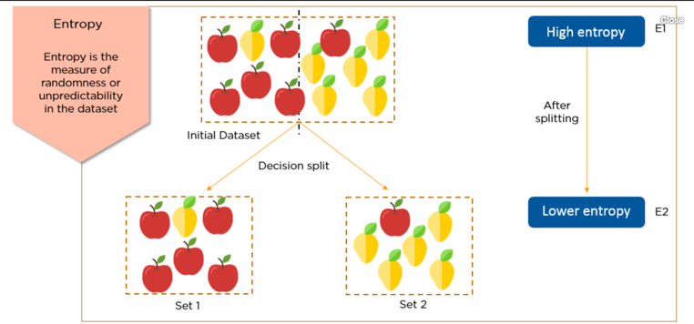
Understanding Entropy
In the initial dataset the fruits(apple and mango) are mixed up. The dataset is said to have a high entropy.

Slide 13
Understanding Entropy
When the dataset is split, the resulting datasets are less random than the previous one. Hence, the entropy has decreased.
Continue to split the dataset till Entropy is Zero

Slide 14
Understanding Entropy and Information Gain
Entropy of each of the divided set is subtracted from the Original entropy before splitting to obtain Information Gain
IG(Set1) = Original Entropy Before split – Entropy(Set1)
IG(Set2) = Original Entropy Before split – Entropy(Set2)

Slide 15
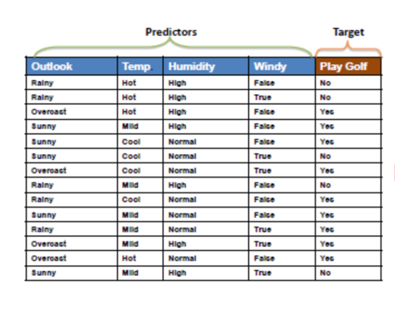
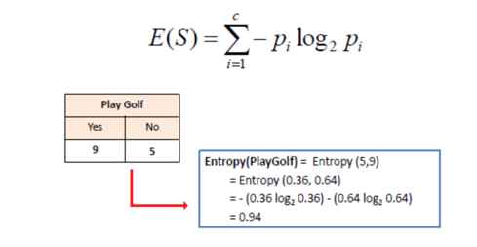
Computing Entropy for outcome variable
Entropy for any given variable is calculated using the below formula with the help of the frequency table
At the start of splitting a features to a form a tree, Entropy is calculated for the target variable as shown below

Slide 16
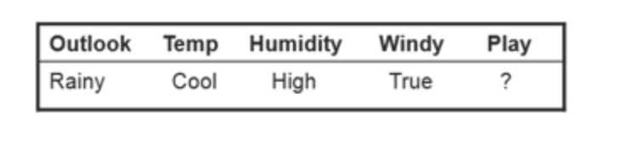
Applying Decision Trees
Consider the Weather data set with the following observations
Using the above dataset we will now have to predict whether to play golf or not given the values for 4 predictors.

Slide 17
Tree splitting exercise
Splitting the tree starts from the root node, where in one of the attributes/features are selected for splitting the dataset
To choose an attribute for splitting
Compute the entropy of every attribute against the target variable.
Compute the decrease in entropy after the split on an attribute, which is called as the information gain

Slide 18
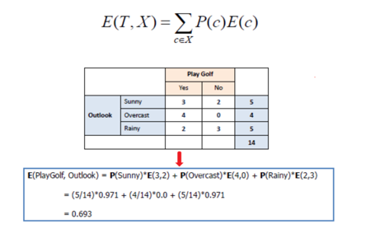
Tree splitting exercise
Lets consider the outlook variable
Find the entropy of playing golf for the outlook variable by constructing the frequency table

Slide 19

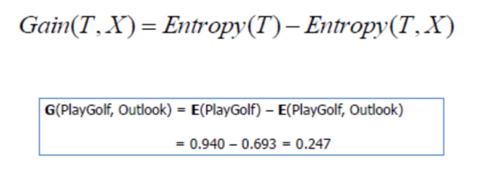
Tree splitting exercise
Compute the Information gain for playing golf for the outlook variable
Notes:
The entropy for each attribute is calculated. Then it is added proportionally, to get total entropy for the split. The resulting entropy is subtracted from the entropy before the split. The result is the Information Gain, or decrease in entropy.

Slide 20
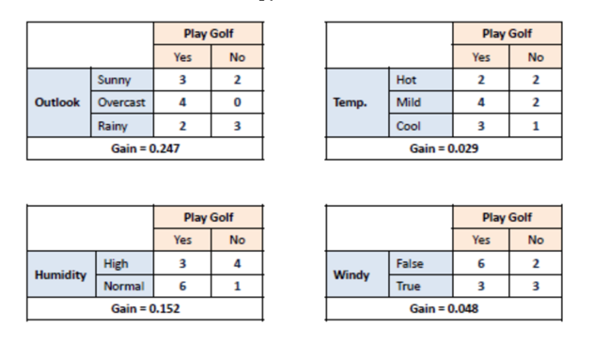
Tree splitting exercise
Compute information gain for every attribute

Slide 21
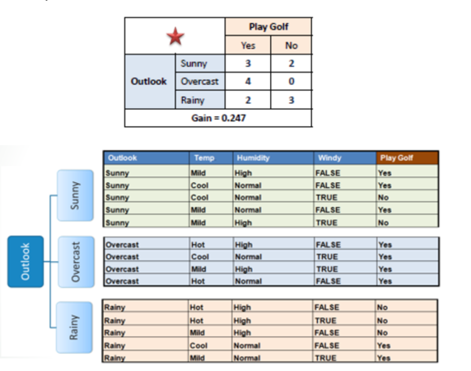
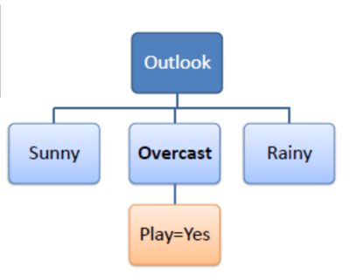
Tree splitting exercise
The attribute with the largest information gain is chosen as the decision node which is used to divide the dataset. This results in the first branch of the tree

Slide 22
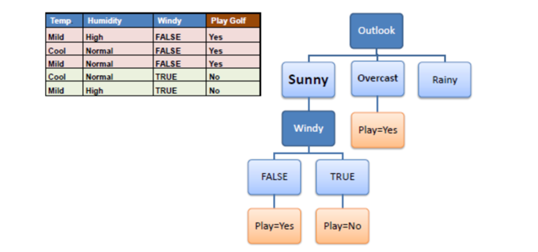
Tree splitting exercise
When to stop splitting - A branch with entropy 0 is the leaf node
The algorithm is run recursively till all the non-leaf branches are classified.

Slide 23
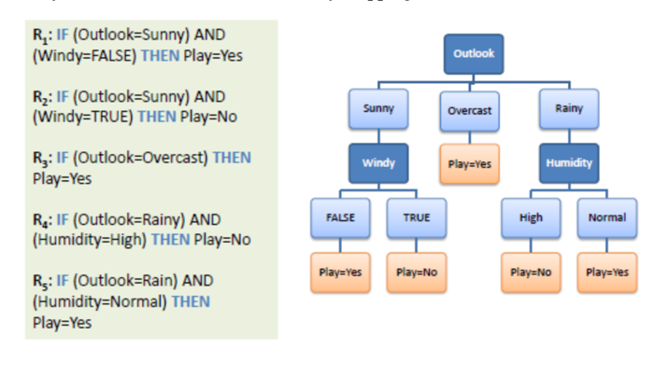
Inferring rules from decision tree
A Decision tree can be easily transformed into a sequence of Rules

Slide 24
DECISION TREE - Assignment
Simple Example
Survived | Pclass | Sex | Age | SibSp | Parch
0 | 3 | male | 22 | 1 | 0
1 | 1 | female | 38 | 1 | 0
1 | 3 | female | 26 | 0 | 0
1 | 1 | female | 35 | 1 | 0
1 | 3 | male | 35 | 0 | 0
0 | 3 | male | 32 | 0 | 0
1 | 1 | male | 54 | 0 | 0
Notes:
https://www.saedsayad.com/decision_tree.htm
To compute Classification error: https://www.youtube.com/watch?v=KLkjK3CHZiA
Decision tree for splitting a numeric feature:
https://www.coursera.org/lecture/ml-classification/optional-picking-the-best-threshold-to-split-on-sKrGp

Slide 25
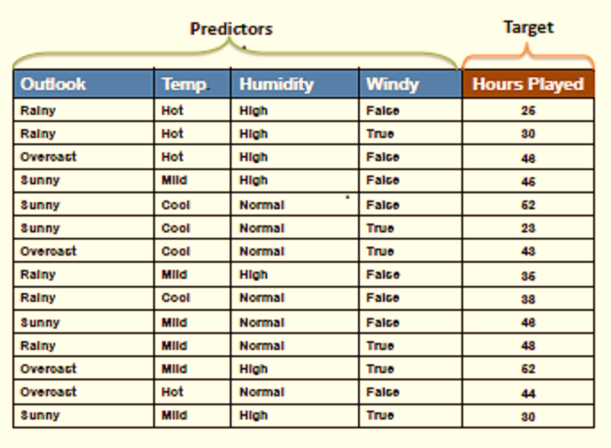
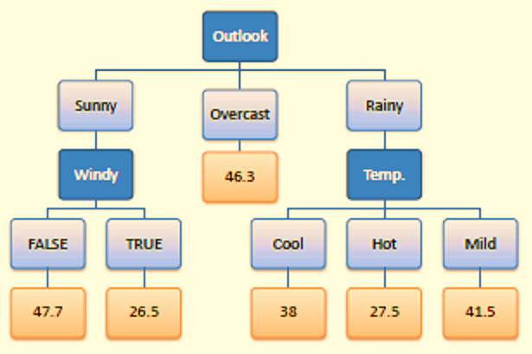
DECISION TREE FOR REGRESSION
When the target variable is a continuous variable, reduction in standard deviation is used as a split criteria instead of information gain
Notes:
Compute the standard deviation of the target. Stdev(Hours Played)
Compute Standard deviation for two attributes (target and predictor). Stdev(Hours Played, Outlook), Stdev(Hours played, Temp), Stdev(Hours Played, humidity), stdev(Hours Played,Windy)
Compute the Standard deviation reduction(subtract stdev(target) and stdev(target and predictor))
The attribute with the largest stdev reduction is chosen as the decision node
Termination criteria : Co-efficient of deviation for a branch is less than a threshold., say 10%
https://www.saedsayad.com/decision_tree_reg.htm

